Slide 1
Identification of all disconnected components of a graph
and
Realignment of the Adjacency and Incidence Matrix to be close to a Diagonal Matrix.
Group members
Yogesh Gupta (IRM2014004)
Akshat Aggarwal (IIM2014005)
Vishesh Middha (ISM2014007)

Slide 2
Identifying disconnected components

Slide 3
#1: Adjacency Matrix
components = []
visited[n] = {false}
Queue q
for vertex = 1 to n do
if !visited[vertex] then
l = []
l.append(vertex)
q.push(vertex)
visited[vertex] = 1
while !q.empty():
u = q.front()
q.pop()
for j = 1 to n:
if graph[u][j] != 0 and !visited[j] then
q.push(j)
visited[j] = true
endif
endfor
endwhile
components.append(l)
endif
endfor

Slide 4
#2: Incidence Matrix
edgeList = [] // Extract list of edges from the incidence matrix
representative = [] // representative of set to which i'th vertex belongs
edgeRepresentative = [] // representative of set to which i'th edge belongs
Initially , representative[i] = i, for all i for i = 1 to m do V1 = edgeList[i].first, V2 = edgeList[i].second repU = findRepresentative(representative, V1) repV = findRepresentative(representative, V2) if repU != repV then // add V2 to the set containing V1 unionSets( repU , repV , representative); endif // Also add i'th edge to corresponding edge set.
edgeRepresentative[j] = repU ; endfor //Associate each vertex and edge with the representative of the set for i = 1 to n do representative[i] = findRepresentative(representative, i) endfor for i = 1 to m do edgeRepresentative[i] = findRepresentative(representative, edgeRepresentative[i]) endfor

Slide 5
vertexComps = [] hash = [] numberofComponents = 0 for i = 1 to n do rep = representative[i] if hash[rep] == 0 then // a new component numberofComponents = numberofComponents + 1 hash[rep] = numberOfComponents tmplist = [] tmplist.append(i) vertexComps.append( tmplist ) else // component has already been discovered, so add vertex i to the respective component vertexComps[hash[rep]].append(i) endif endfor edgeComps = [] for i = 1 to m do rep = edgeRepresentative[i] edgeComps[hash[rep]].append(i) endfor

Slide 6
Realigning to Diagonal Matrix

Slide 7
#1: Adjacency Matrix to Diagonal Matrix
k = 1
indexing = []
reverseIndexing = []
for list in components:
for vertex in list:
indexing[k] = vertex
reverseIndexing[vertex] = k
k += 1
endfor
endfor
for i = 1 to n do
u = indexing[i]
for j = 1 to n do
if graph[u][j] != 0 then
v = reverseIndexing[j]
res[i][v] = 1
endfor
endfor

Slide 8
#2: Incidence Matrix to Diagonal Matrix
result[n][m] = {0} // provide new labelings for the rows of result matrix vertexLabelings = [] for component in vertexComps do for val in component do vertexLabelings.append(val) endfor endfor // fill the result matrix column by column, with value 1 if there is an edge between vertex and edge c = 1 // c - used for iterating over the columns of result matrix for component in edgeComps do for val in component do from = edgeList[val].first, to = edgeList[val].second; // Get new labelings for vertices from and to newfrom = vertexLabelings[from]; newto = vertexLabelings[to]; res[newfrom][c] = 1; res[newto][c] = 1; c = c + 1 endfor endfor

Slide 9
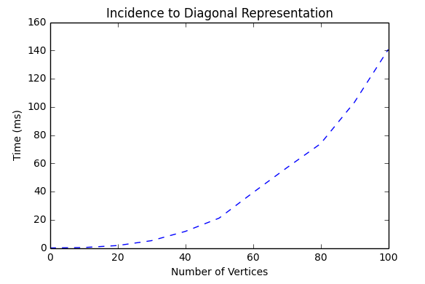
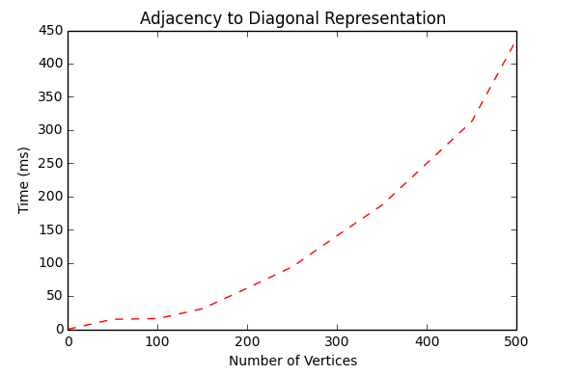
Results & Conclusions
Incidence Matrix
Adjacency Matrix

